Slide 1
Beam profile characterisation of emitters for terahertz wireless links
Jess Smith^{1,2}, Mira Naftaly²
Chris Graham³, James Seddon³, Michele Natrella³, Cyril Renaud³
Simon Nellen⁴, Sebastian Lauck⁴, Björn Globisch⁴
¹Surrey University, Guildford, UK
²National Physical Laboratory, Teddington, UK
³UCL, London, UK
⁴Fraunhofer Institute for Telecommunications,
Heinrich Hertz Institute, Berlin, Germany

Slide 2
Photoconductive emitters – uni-travelling carrier (UTC) diodes & PIN diodies
Photoconductive mixers are the most widely used type of transmitter device for THz communications
Photoconductive mixers generate THz as frequency difference between two CW lasers with (variable) offset wavelengths
Laser 1
Photomixer (UTC or PIN)
Laser 2
Optical fibre
Notes:
Photoconductive emitters belong to the type devices termed “microwave photonics”. Their advantage for THz comms is that optical signal travelling down optical fibres can be directly converted into the THz signal. The UTC in these measurements was designed and fabricated at UCL. The PIN diode is a commercial device manufactured by HHI Fraunhofer.

Slide 3
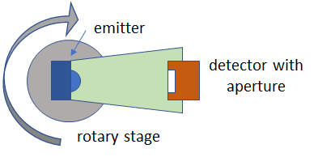
Measurement setup
Notes:
Stage resolution, i.e. step size, is 0.2°. However, measurement resolution is much larger (coarser) and is determined by the detector aperture and the detector-emitter distance. We measure at a distance of about 30 mm and an aperture of 2-4 mm depending on the emitted power.

Slide 4
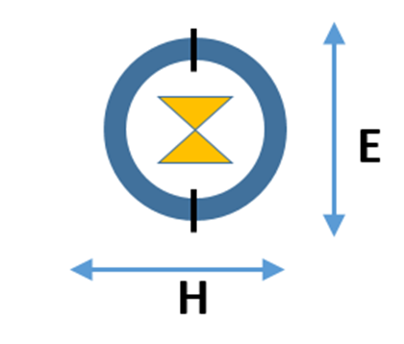
Emitter field planes
Head-on view of the Emitters
Polarization
Notes:
Both UTC and PIN diodes emit polarised radiation, with different radiation patterns expected along the two orthogonal axes. The E-field in parallel to the polarization; the H-field is normal to the polarization.

Slide 5
UTC diode
The tested UTC device is optimised at 250 GHz
E-field
H-field
Notes:
We present normalised power because we are focusing on the beam profile, and it is clearer comparison when data is normalised. We present data on both linear and log scales because some of us – and in the audience – predominantly use linear and others use log.

Slide 6
UTC diode
Beam profile at 240 GHz
E-field
H-field

Slide 7
UTC diode
Beam profile at 230 GHz
E-field
H-field

Slide 8
UTC diode
Beam profile at 260 GHz
E-field
H-field

Slide 9
UTC diode
Beam profile at 270 GHz
E-field
H-field

Slide 10
UTC diode
Comparison of beam profiles – E-field

Slide 11
UTC diode
Comparison of beam profiles – H-field

Slide 12
PIN diode - a broadband emitter
Beam profile at 100 GHz
E-field
H-field
Notes:
The PIN diode is designed as a broadband emitter operating from 30 GHz to 2.5 THz. In these measurements we focus on frequencies most relevant to THz communications.

Slide 13
PIN diode - a broadband emitter
Beam profile at 150 GHz
E-field
H-field

Slide 14
PIN diode - a broadband emitter
Beam profile at 200 GHz
E-field
H-field

Slide 15
PIN diode - a broadband emitter
Beam profile at 250 GHz
E-field
H-field

Slide 16
PIN diode - a broadband emitter
Beam profile at 300 GHz
E-field
H-field

Slide 17
PIN diode
Comparison of beam profiles – E-field

Slide 18
PIN diode
Comparison of beam profiles – H-field

Slide 19
PIN diode
Comparison of beam profiles – E-field (c. 250 GHz)

Slide 20
UTC diode
Comparison of beam profiles – E-field

Slide 21
PIN diode
Comparison of beam profiles – H-field (c. 250 GHz)

Slide 22
UTC diode
Comparison of beam profiles – E-field

Slide 23
Measurement aspects - repeatability
Mean & standard deviation of 9 measurements
Notes:
This data shows repeatability of measurements when the emitter and detector alignment is kept constant.

Slide 24
Measurement aspects - alignment
UTC @ 250 GHz E-field
Horizontal alignment
Vertical alignment
Notes:
These are examples of signal variation with alignment between the emitter and detector axes.

Slide 25
Conclusions
The beam profiles of UTC and PIN diode emitters have unexpected spatial features
These features are irregular and asymmetric
These features vary with frequency and polarisation plane
The presence of such features makes beam profile measurements an essential part of device characterisation

Slide 26
Thank you
This project has received funding from Horizon 2020, the European Union’s Framework Programme for Research and Innovation, under grant agreement No. 761579 “TERAPOD”.

